Slide 1

2021年3月“七彩阳光”
高三下返校联考读后续写讲评
——圣诞买新衣

Slide 2
读后续写（满分25分）
阅读下面短文，根据所给情节进行续写，使之构成一个完整的故事。
The Wilsons were having dinner. The food was left from their Thanksgiving dinner two days before：turkey soup and turkey meat mixed with potatoes . Eleven-year-old Angelina asked，”Are we having turkey ice cream, too?” Her father replied, “Angelina, have you forgotten that I had no job for a whole year? Now I have work again. You should be very thankful.” “I'm sorry I said that about the turkey! But unless I get a new dress，I will not look good for the Christmas Festival.” Angelina murmured.
The Festival was the winter holiday celebration of a group she belonged to: the Avalon Girls' Service Club. They wrote cheerful cards for hospital patients. They cooked meals for the homeless .But the Christmas Festival was different . The girls wore party clothes and many people came to see them perform. Angelina had only a plain gray dress that she had worn to the event last year .And now it was a little too short. Angelina appealed to her parents to buy one for her, a beautiful red dress in Forbes' Store. Her mother sighed, “Well, we can not buy it. We have to be careful. You never know when I might lose my job.”
All hope was not gone.There was a sign in the Forbes’ store window that said”layaway(分期付款)”. Angelina pulled ten worn dollar bills from her coat pocket .She ran to the store and begged the salesperson, Mrs.Harding, to hold ’her’ dress for her. ”Ok. But you must come back in two weeks to pay the rest” Angelina felt like jumping into the air. She was so happy that she told Mrs. Harding about the Avalon Service Club's work and its Christmas party .
Then, Angelina shook and suffered in the cold wind looking for work. Finally, Angelina got a job making new clothing for dolls. Angelina was excellent at sewing. Sure enough, the dolls' dresses turned out beautiful. She got twenty dollars. Still，she was far from having enough money for her dress . She felt helpless as the final payment date arrived .
She returned sadly to Forbes' Store, “I don't have enough money for the dress.” Then she saw Mrs.Harding's eyes were red. She looked like she had been crying .She said the store was closing and she was losing her job.

Slide 3
The Wilsons were having dinner. The food was left from their Thanksgiving dinner two days before：turkey soup and turkey meat mixed with potatoes . Eleven-year-old Angelina asked，”Are we having turkey ice cream, too?” Her father replied, “Angelina, have you forgotten that I had no job for a whole year? Now I have work again. You should be very thankful.” “I'm sorry I said that about the turkey! But unless I get a new dress，I will not look good for the Christmas Festival.” Angelina murmured.
The Festival was the winter holiday celebration of a group she belonged to: the Avalon Girls' Service Club. They wrote cheerful cards for hospital patients. They cooked meals for the homeless .But the Christmas Festival was different . The girls wore party clothes and many people came to see them perform. Angelina had only a plain gray dress that she had worn to the event last year .And now it was a little too short. Angelina appealed to her parents to buy one for her, a beautiful red dress in Forbes' Store. Her mother sighed, “Well, we can not buy it. We have to be careful. You never know when I might lose my job.”
During the dinner, father taught Angelina to be thankful because he had no job for a whole year but Argelina insisted a new dress for a party .
Angelina begged her mother to buy the new dress for the Christmas Festival, which was refused.

Slide 4
All hope was not gone.There was a sign in the Forbes’ store window that said”layaway(分期付款)”. Angelina pulled ten worn dollar bills from her coat pocket .She ran to the store and begged the salesperson, Mrs.Harding, to hold ’her’ dress for her. ”Ok. But you must come back in two weeks to pay the rest” Angelina felt like jumping into the air. She was so happy that she told Mrs. Harding about the Avalon Service Club's work and its Christmas party .
Then, Angelina shook and suffered in the cold wind looking for work. Finally, Angelina got a job making new clothing for dolls. Angelina was excellent at sewing. Sure enough, the dolls' dresses turned out beautiful. She got twenty dollars. Still，she was far from having enough money for her dress . She felt helpless as the final payment date arrived .
She returned sadly to Forbes' Store, “I don't have enough money for the dress.” Then she saw Mrs.Harding's eyes were red. She looked like she had been crying .She said the store was closing and she was losing her job.
Angelina decided to layaway in Forbes’ Store, giving the salesperson ten dollars,
and asked Mrs. Harding to hold “her“ dress for her for two weeks.
Angelina got a job and worked hard to earn money.
Yet the money was not enough.
When she returned to the store, Mrs. Hardings told her she was losing her job.

Slide 5
注意：
1.所续写短文的词数应为150左右；
2.至少使用5个短文中标有下划线的关键词语；
3.续写部分分为两段，每段的开头语己为你写好；
4.续写完成后，请用下划线标出你所使用的关键词语。
Paragraph1:
Suddenly, Mrs Harding said that she would pay the rest of the money so Angelia
could have it.
Paragraph2:
Outside, Angelina saw a man who looked like Santa Claus was asking people for money to help poor people.

Slide 6
puzzles to solve:
Why did Harding offer to help Angelina? Was she rich?
accept the offered help or not?
If she accepted the help, what if Mrs Harding lost the job?
If she refused the help, how did she deal with the dress problem?
Who is the man outside? father? stranger？
If the man is her father, why did he do so? to buy her the dress?
上下两段不是两个独立的故事，应该是有紧密联系的，主要矛盾就是如何解决裙子的问题(若在第一段解决了问题，场面就会铺的很大
情节无疑会很复杂，尽量不要给自己挖坑
在这个似乎人人都困难的时期，通过小女孩为圣诞晚会买新的漂亮裙子的故事传达怎样的道理？通过这个这个解决裙子问题的过程，小女孩自身成长了吗？What's the theme of the passage?

Slide 7
Read for hidden clues
1. Her father replied, “Angelina, have you forgotten that I had no job for a whole
year? Now I have work again. You should be very thankful.”
her father: thankful/grateful
2. Her mother sighed, “Well, we can not buy it. We have to be careful. You never know when I might lose my job.”
her mother: careful
3. They wrote cheerful cards for hospital patients. They cooked meals for the
homeless .
Angelina: warm-hearted/generous
4. The girls wore party clothes and many people came to see them perform.
Angelina had only a plain gray dress …… a little too short.
Angelina: eager for a new dress
5. Then she saw Mrs.Harding's eyes were red. She looked like she had been crying.She said the store was closing and she was losing her job.
Mrs. Harding: needy( in trouble)
6.Angelina was excellent at sewing. Sure enough, the dolls' dresses turned out beautiful.
Angelina was good at sewing.

Slide 8
Read for main conflicts
Conflict1: Whether to acccept the offered dress?
Conflict2: Whether to buy the dress or not?
Conflict3: What did she do at the sight of the man outside?
Donate her money?
What's the theme of the story ?

Slide 9
Infer possible solutions
Angelina dreamed of having a new dress.
Mrs.Harding was losing her job ; she was needy.
Paragraph1:
Suddenly, Mrs Harding said that she would pay the rest of the money so Angelia could
have it.
What's Angelina's immediate response to the offered help? (delighted?)
Would Angelina refuse Mrs. Harding’s offered help at a second thought?
with the money or the dress.
Angelina walked out of the store
Paragraph2:
Outside, Angelina saw a man who looked like Santa Claus was asking people for money to
help poor people.
Angelina’s club was warm-hearted and generous.
Angelina decided to donate her money.
Ambivalent(struggling with choices)?
What possibly led to her decision?
her father/mother?Mrs Harding?
her inner kindness?
What 's her solution to her dress?

Slide 10
The main possible plots:
Angelina was happy ...
Angelina refused the offered help.
Angelina left the store.
She donated her money.
The man’s response to her kindness.
She decided to doing some sewing to beauty her old dress.

Slide 11
The change of the feelings
feelings at first
observation
reflection
feelings in the end
What to observe and how to describe it
What to reflect and how to describe it

Slide 12
2021.3 十校联考 The missing bolt
Dad called the stores but none carried the bolt that fitted this old van.
Then it hit me. “Max!” I shouted, “Find Max!”
How did i feel?
what did i observe (dad)?
What did i think of?
what’s my decision?

Slide 13
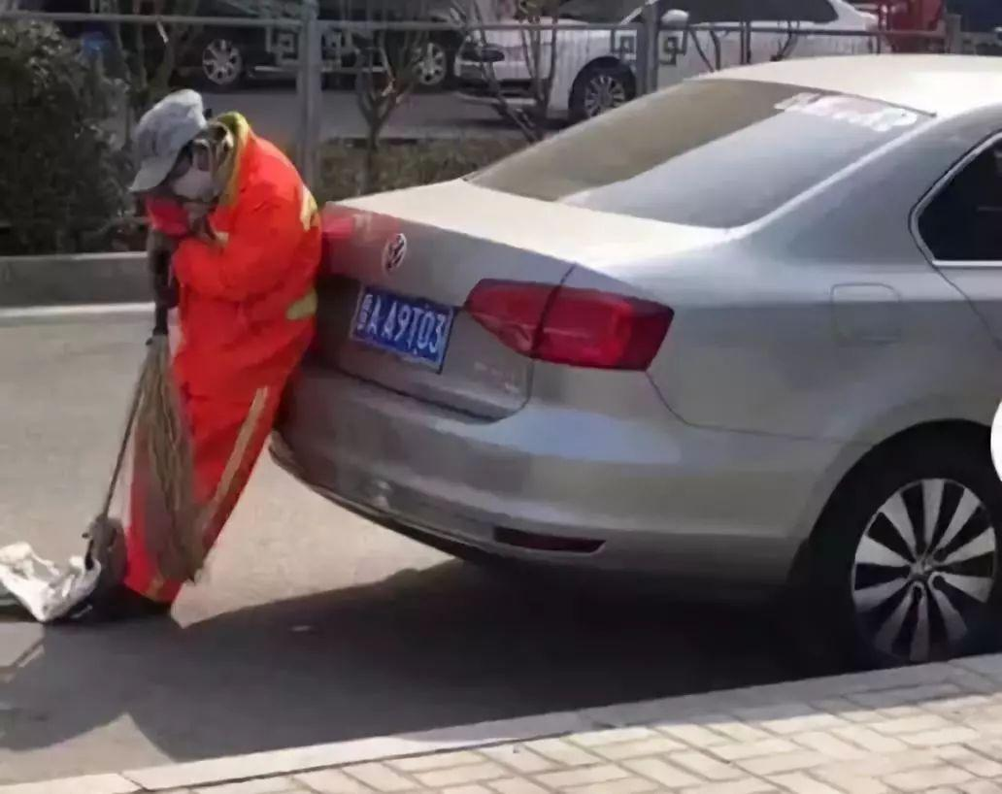
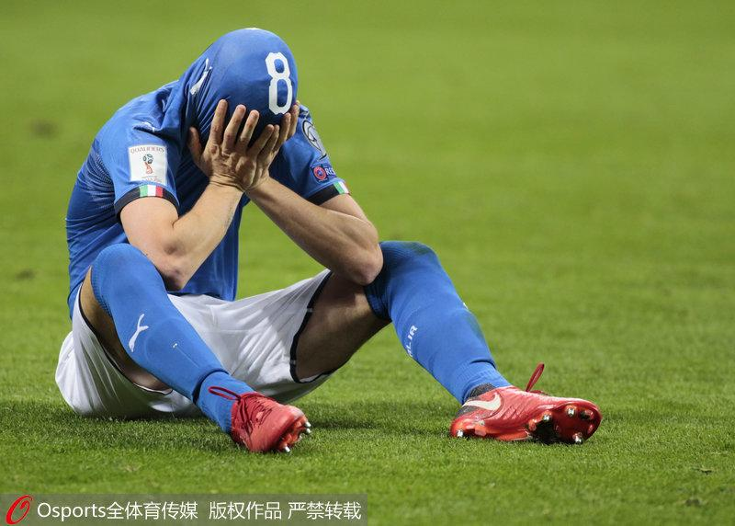
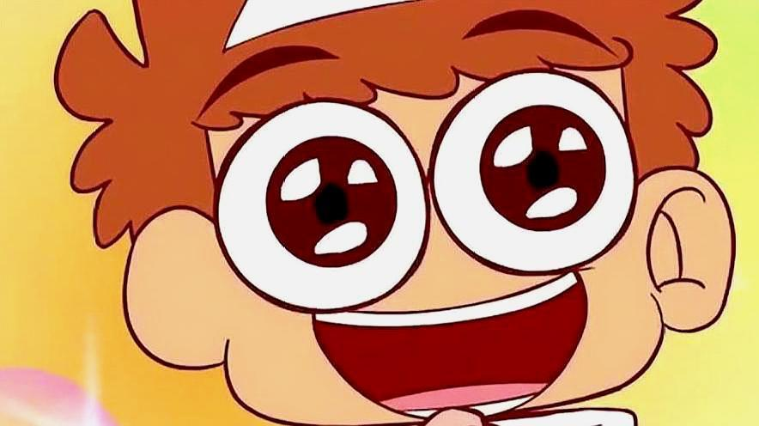
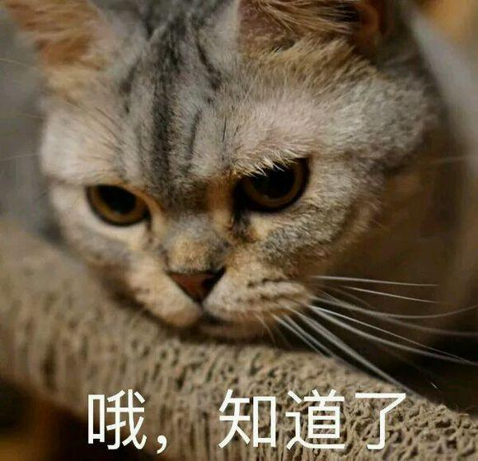
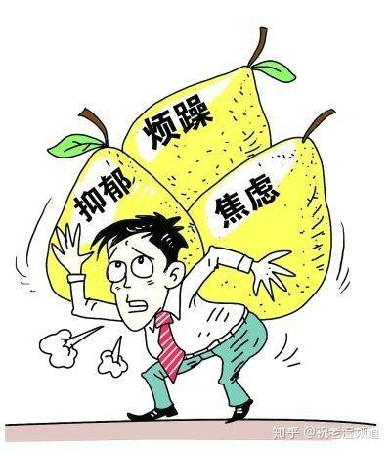
Sentence patterns to describe your observation of sb I noticed the tears in my father's eyes and the pain in his tone.
1. I noticed the __________ in his eyes and the ________ in his tone.
2. I looked back and saw the lonely figure of my father, who was leaning over the van, face clouded with gloom.
我抬起头看到了她，她倚靠在车上，太累了以至于头也抬不起来。
I lifted my head and caught sight of her, who was leaning on the car, too tired to lift her head.
3. There he was, leaning over the van, face clouded with gloom.
怎么办
他就在那儿，坐在草地上，脸埋在手里。
There he was, sitting on the grass, face buried in his hands.
Wow！

Slide 14
Match the content with the description
Seeing the floating pieces of ice, I suddenly realized that it was global warming caused by human activities that led to the loss of their food and habitat. --- Encounter with a Polar Bear
Past experiences and memories
The sudden awareness of some fact
Sb’s love, devotion and so on
The sight of the empty house and the elaborately-wrapped Bible reminded him of not only his forever loss of his father but also the deep love his father had for him. --- Graduation Gift
Much to my surprise, I enjoyed the video, which reminded me of the how funny I was and how amused my families were on that day.
--- My Head got Stuck in a Pumpkin

Slide 15
What to reflect and how to describe it
The sight of it reminded him of their busy figures and hopeful expressions , which drove me to move towards him.
Visions of their busy figures and hopeful expressionsmarched before my eyes,
which drove me to move towards him.
I suddenly realized that the fact that his dream—The Trip of a Lifetime—was vanishing before his eyes hit him a heavy blow.
What to reflect
Sentence patterns to describe it
the sudden awareness of some fact
past experiences and memories
sb’s love and devotion
I suddenly realized that..
I became aware of…
The sight of it reminded me of…
It hit / struck/ occurred to / dawned on me that
Visions of sth. marched before my eyes

Slide 16
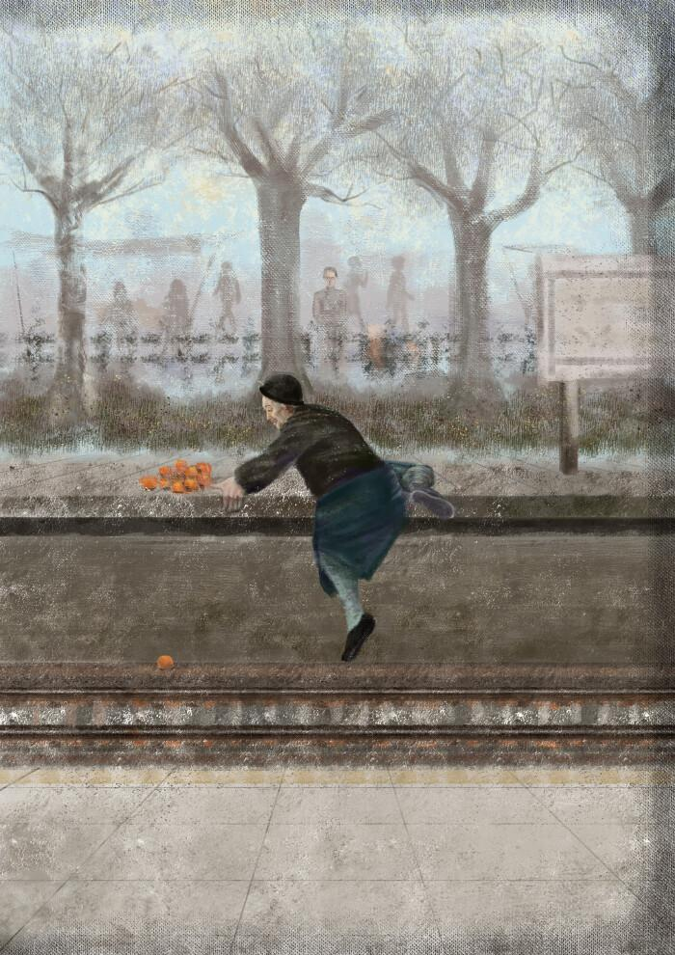
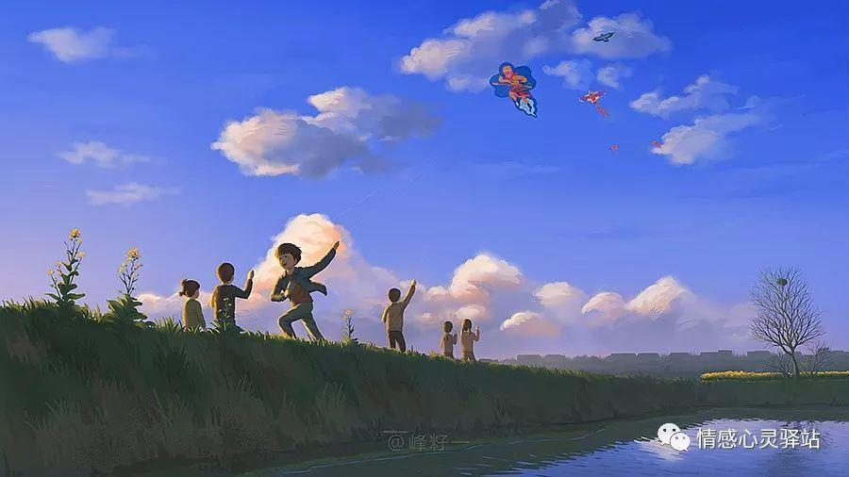
Sentence patterns to describe your reflection
I suddenly realized that..
I became aware of…
The sight of it reminded me of..
It hit / struck/ occurred to / dawned on me that
Visions of sth. marched before my eyes
It suddenly hit me that _____________________ ________________________________________ (父亲已经五十多岁了，他日渐苍老)
The sight of it reminded me of _______________
(我们所经历的起起伏伏 / 我们所分享的苦乐回忆 / 父亲给予我的爱与支持)
3. Visions of _________________________________ ____________________ marched before my eyes.
father was in his fifties
and was grey with age.
flying a kite and running happily on the
field with my friends

Slide 17
Appreciation
Dad called the stores but none carried the bolt that fitted this old van. Maybe we were not going on The Trip after all. Visions of diving at the lake and hanging out with friends happily marched before my eyes. My soul silently rejoiced. But then I caught sight of the lonely figure of Dad, who was leaning over the van, face clouded with gloom. “The trip would be a bubble!”,dad forced a smile.I noticed the gloom in his eyes and the depression in his tone.The sight of it reminded me of all the expectations and excitement earlier he had for the Trip. But now, the Trip —The Trip of a Lifetime—was vanishing before his eyes. I couldn’t bear to see Dad so disappointed. “I will have to find that bolt for Dad” I murmuered to myself determinedly.
what I felt
what I observe
what I reflect
what I decided

Slide 18
observation & reflection
Visions of sth. marched before my eyes
I noticed the ____ in his eyes and the _____ in his tone.
He looked back and saw sb, who was ____, face/hands/.. ___
There he was, doing
I suddenly realized that.. / I became aware of…
The sight of it reminded me of…
It hit / struck/ occurred to / dawned on me that

Slide 19
Suddenly, Mrs Harding said that she would pay the rest of the money so Angelia could have it.
How did Angelina feel then?
What did Angelina observe then?
What's Angelina's reflection then?
What’s her final decision?

Slide 21
How did Angelina feel then?

Slide 22
A surge of excitement ran through her at the sound of what Mrs Harding said.
She gasped at what Mrs harding said, her eyes twinkling with excitement./excitement dancing in her shining eyes.
Hearing this, she stood rooted there, her face brimming with astonishemnt and eyes dancing with excitement.
This commitment made Angelina ecstatic , her heart thumping wildly. The fantastic scene of her peers in the club surrounding her and casting envious and worshiping look over at the Christmas party flashed across her mind. Her face flushed and eyes sparkled.

Slide 23
What did Angelina observe then?

Slide 24
Angelina noticed the tears in her eyes and the sorrow in her tone.
Angelina looked up and saw the lonely figure of Mrs Harding, who was leaning over the window of the store, face clouded with gloom and eyes red with tears.
There Mrs Harding was, leaning over the window of the store, face clouded with gloom and eyes red with tears.
Giggles and chuckles were to sound when a depressed face with red eyes reflected into her eyes.

Slide 25
What's Angelina's reflection then?

Slide 26
The sight of it reminded Angelina of how sad and depressed her father felt during that long year when he had no work.
Visions of her father's depression and mother's anxiety during that long jobless year marched before Angeliana's eyes.

Slide 27
One possible version
Suddenly, Mrs Harding said that she would pay the rest of the money so Angelia could have it. This commitment made Angelina ecstatic , her heart thumping wildly. The fantastic vision of her peers in the club surrounding her and casting envious and worshiping look over at the Christmas party marched before Angeliana's eyes. Her face flushed and eyes sparkled. Giggles and chuckles were to sound when a depressed face with red eyes reflected into her eyes. There Mrs Harding was, leaning over the window of the store, face clouded with gloom and eyes red with tears.The sight of it reminded Angelina of how sad and depressed her father felt during that long year when he had no work. She felt a little ashamed for her momentary selfish thought of beautifying herself regardless of the hard situation of Mrs Harding. Her accepting heart withdrew. “Thank you very much indeed for your kindness! Mrs Harding!” said Angelia, “Merry Christmas to you and good luck for your job hunting!” She strode out.

Slide 28
One possible version
Suddenly, Mrs Harding said that she would pay the rest of the money so Angelia could have it. A surge of excitement ran through her at the sound of what Mrs Harding said.The fantastic vision of her peers in the club surrounding her and casting envious look over at the Christmas party marched before Angelina's eyes. Then a depressed face with red eyes reflected into her eyes. There Mrs Harding was lost in thought, face clouded with gloom, which reminded Angelina of how depressed her father felt during that long jobless year. She felt ashamed for herself. “Thank you indeed for your kindness!” said Angelia, “Merry Christmas and good luck for your job hunting!” She strode out. 99
what she felt
what she observed
what she reflected
what she decided

Slide 29
Outside, Angelina saw man who looked like Santa Claus was asking people for money to help poor people. Angelina stood still for moment on the snowy sidewalk. Then, quite suddenly, she gave the man dressed as Santa Claus several dollars. "Mrs. Harding is not the only one who wants to help other people." Just as suddenly she decided that maybe she would buy some material to add length to her old gray wool dress. And she started to plan how she would sew bright red ribbons along the neckline. Who knew, maybe she could look good at the Festival after all. But, in any event, she would have fun. After all, it was Christmas time.

Slide 30
Outside, Angelina saw a man who looked like Santa Claus was asking people for money to help poor people. Standing in the hard blowing wind and fluttering dense snowflakes, he was seen busy warmly greeting and saying “Thank you! Merry Christmas!” to the pedestrians dropping money in the charity box. “Donate it or keep it for myself？”she pondered, with a conflicting heart, holding tightly the twenty- dollar bill she had earned by sewing hard doll clothing. The haunting red-eyed Mrs Harding as well as the broad smile of the man when receiving money determined her choice.She marched forward and dropped the money in the box. Snowflakes were still dancing along with her dream of children all wearing beautiful dresses. Suddenly it occurred to her that she would buy some material to add length to her old gray wool dress.Smiles dancing in her eyes,Angelina beamed at herself, “Merry Christmas!” Melodious Christmas songs were on and on in her ears!

Slide 31
The change of the feelings
feelings at first
observation
reflection
feelings in the end
What to observe and how to describe it
What to reflect and how to describe it

Slide 32
observation & reflection
Visions of sth. marched before my eyes
I noticed the ____ in his eyes and the _____ in his tone.
He looked back and saw sb, who was ____, face/hands/.. ___
There he was, doing
I suddenly realized that.. / I became aware of…
The sight of it reminded me of…
It hit / struck/ occurred to / dawned on me that

Slide 34
2021.3 十校联考 The missing bolt
Dad called the stores but none carried the bolt that fitted this old van. Maybe we were not going on The Trip after all. I was overjoyed. Visions of ....
Then it hit me. “Max!” I shouted, “Find Max!”
observation & reflection
Visions of sth. marched before my eyes
I noticed the ____ in his eyes and the _____ in his tone.
He looked back and saw sb, who was ____, face/hands/.. ___
There he was, doing
I suddenly realized that.. / I became aware of…
The sight of it reminded me of…
It hit / struck/ occurred to / dawned on me that

Slide 35
Outside, Angelina saw a man who looked like Santa Claus was asking people for money to help poor people. Standing in the hard blowing wind and fluttering dense snowflakes, he was seen busy warmly greeting and saying “Thank you! Merry Christmas!” to the pedestrians dropping money in the charity box, a face brimming with happiness. “Donate it or keep it for myself？”she pondered, with a conflicting heart, holding tightly the twenty- dollar bill she had earned by sewing hard doll clothing, “The former will go to the needy people for life necessities and the latter, the long-expected dress , maybe, is just to show off.” The haunting red-eyed Mrs Harding as well as the amazingly similar-seeming life scene where her father had been laid off determined her choice. She stepped up and gave him her money in the admiring look of the Santa Claus and other donators. Snowflakes were still dancing along with her dream of children all wearing beautiful dresses. Melodious Christmas songs were on and on!

Slide 36
Appreciation
Dad called the stores but none carried the bolt that fitted this old van. Maybe we were not going on The Trip after all. Visions of diving at the lake and hanging out with friends happily marched before my eyes. My soul silently rejoiced. But then I caught sight of Dad, who was leaning over the engine, his head lowered and hands black with grease. The sight of it reminded me of all the expectations and excitement earlier he had for the Trip. But now, the Trip —The Trip of a Lifetime—was vanishing before his eyes. I couldn’t bear to see Dad so disappointed. “I will have to find that bolt for Dad” I murmuered to myself determinedly.

Slide 37
Related writing materials
Expressions to show “happy”
1. Bathed in sunshine, we all cheered and jumped with joy. 2. The crowd became restless(骚动), excitement filling the room. 3. Tears of happiness poured down Susan’s cheeks. 4. Craig felt the wind touching his face merrily with brilliant sparkle in his eyes.
5. His eyes twinkled with pleasure every time he remembers last winter.
6. Smiles are dancing in his eyes./Her eyes danced with joy and happiness.
7. This commitment made Angelia ecstatic , her heart thumping wildly.
8. I beamed at(对...微笑) him, “Welcome back,...”
9. A surge of excitement/delight ran through me, as if I were the king.
10. Hearing this, everybody was wild with joy.
11. His face was brimmed with happiness.
12. One evening, standing under a jeweled sky, I found myself thankful for
all the hardships.

Slide 38
“guilty”& “ashamed”
1. Guilt engulfed him at the thought of killing the cow.
2. A unique sense of guilt arises.
3. She felt so ashamed that she could feel her face burning.
4. So ashamed was she that she could feel the blood rush to her face.
5. So ashamed did he feel that she was close to tears.
“ambivalent” &“hesitant”
1. I hesitated, and was momentarily uneasy that guilt crossed my face.
2. At the sight of this, I began to feel a little uneasy. With the night falling, I was on pins and needles.
3. A mixed sense of embarrassment and guilt clung upon her.
4. “Donate it or keep it for myself？”she pondered, with a conflicting heart.

